Slide 1


ME781 COURSE PROJECT
Guide : Prof. Asim Tewari
Image Super-resolution and Deblurring Model
GROUP 19
PARAG BAJAJ | 190100088
MOITREYEE SARKAR | 18D170020
REET MEHTA | 180020077
ABHINAV KANT MISHRA | 203110051
Project Code link

Slide 2

PROJECT OBJECTIVE
01

Slide 3

The objective of this project is to upscale and improve the quality of low resolution images using Machine Learning techniques incorporated with Wavelet transform for images.
The goal is to train a Machine Learning model that provides output high resolution images based on low resolution image by predicting wavelet coefficients which is better than tradition extrapolation, bilinear or bicubic methods, and is, at worst, comparable in time to these traditional algorithms.
We would also like to explore the possibility to combine this idea with a deblurring and denoising model to increase its applications in a practical world.

Slide 4
PROBLEM DEFINITION
02

Slide 5
The application developed will take any input low-resolution image and upscale it to high-resolution. We will also explore how we could add more functionalities of deblurring and denoising to the same.
It can be used for any kind of people who click photos digitally, from beginners to professional photographers.
Upscaling of resolution is provided by applications like Photoshop which are usually paid and require a professional to work with it. This AI based super resolution technique will provide free of cost automatic super resolution options, which literally anybody can find handy.

Slide 6
03
DENOISING &
SUPER RESOLUTION OF IMAGES

Slide 7
PROPOSED METHOD
Deep networks are applied to image generation by learning generator/decoder networks x = f_{θ}(z) that map a random code vector z to an image x.
Our aim is to investigate the prior implicitly captured by the choice of a particular generator network structure, before any of its parameters are learned
Parametrization x = f_{θ}(z) of an image x ∈ R^{3✕H✕W}
Most of our experiments are performed using a U-Net type “hourglass” architecture with skip-connections, where z and x have the same spatial size.

Slide 8
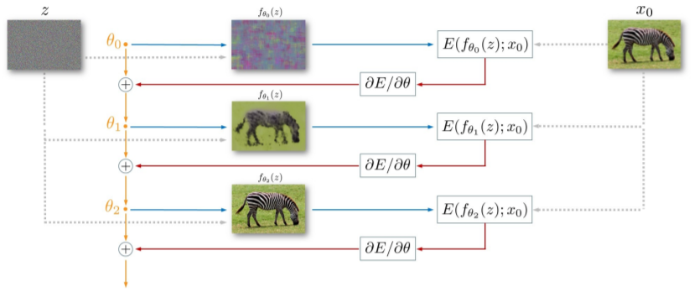
PROPOSED METHOD

Slide 9
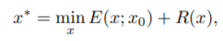
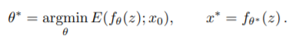
PROPOSED METHOD
To demonstrate the power of this parametrization, we consider inverse tasks such as denoising, super-resolution and inpainting.
where E(x; x0) is a task-dependent data term, x0 the noisy/low-resolution/occluded image, and R(x) a regulariser
In this work, we replace the regularizer R(x) with the implicit prior captured by the neural network, as follows:

Slide 10
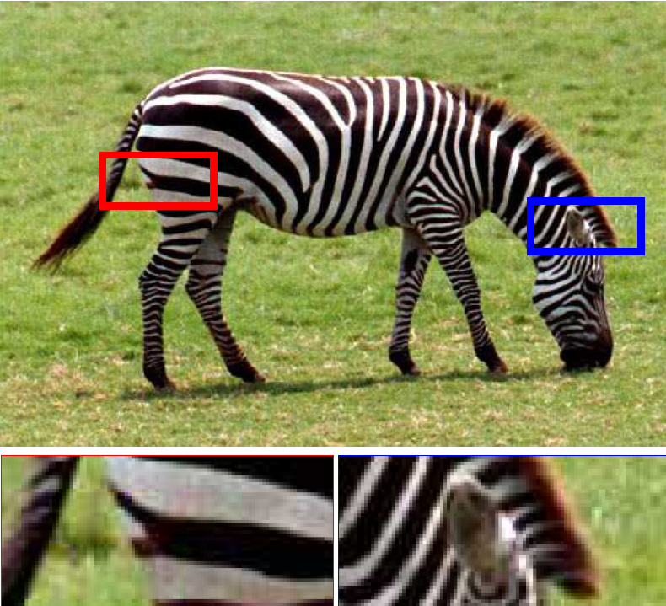
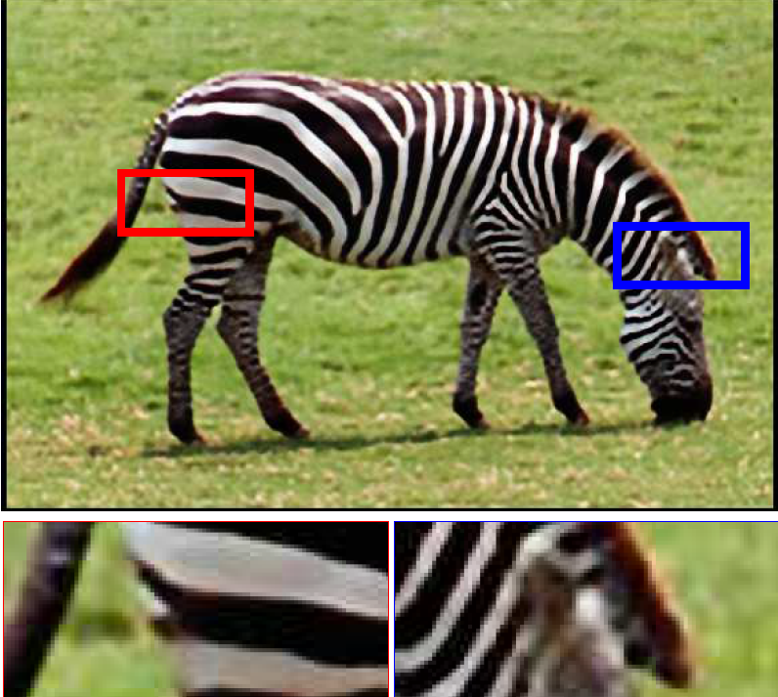
Super-Resolution using the Deep Image Prior
Ground Truth (Low Resolution Image SR: High Resolution Image after Using Deep Prior
Of zebra): The only used image

Slide 11
PSNR Comparisons with other methods
Implementation of SR
Downsampling is done using operator d() that resizes an image by a factor t given by
d(·) : R(3×tH×tW) → R(3×H×W)
Next, Regularizing the problem (given in method section) is done by considering the re-parametrization x = fθ(z) and optimizing the resulting energy w.r.t. θ. Optimization which uses gradient descent
1. 4X Super-Resolution
IMAGE | DEEP PRIOR | BEST
LR Zebra | 25.71 | 26.98 (LapSRN)
2. 8X Super-Resolution
IMAGE | DEEP PRIOR | BEST
LR Zebra | 20.62 | 20.62 (DEEP PRIOR)

Slide 12
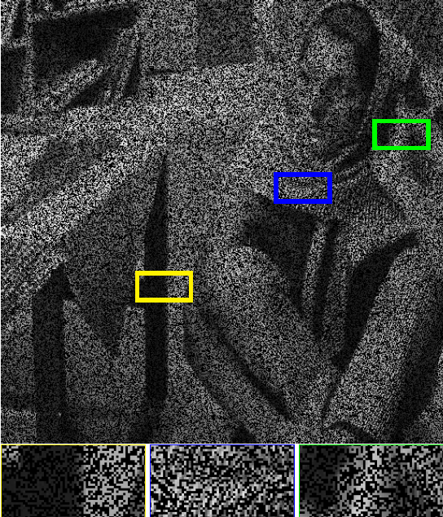
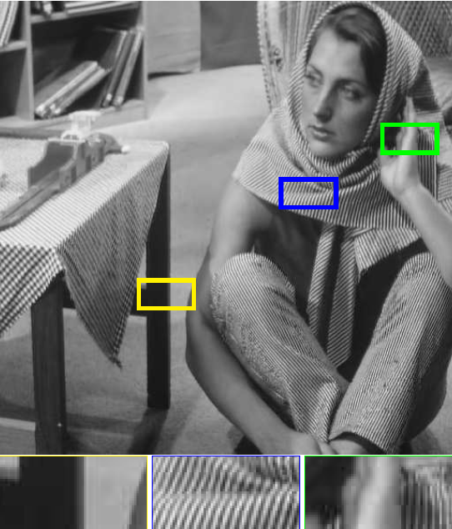
2. Denoising using the Deep Image Prior
Corrupted Image used Image after Deep Image Prior

Slide 13
04
IMAGE DEBLURRING
USING MACHINE LEARNING

Slide 14
PROPOSED METHOD
Three models have been tried out:
These models are less complicated than Neural Network models.
Tried these models for patch width ranging from 11 to 71
Anything smaller than 11 would have been too small to analyse accurately.
Anything larger than 71 would have been too much to extract a local pixel intensity value and would have overfit the model
SVR Regression on HSV
SVR Regression on RGB channels separately
Random Forest Regression on HSV

Slide 15
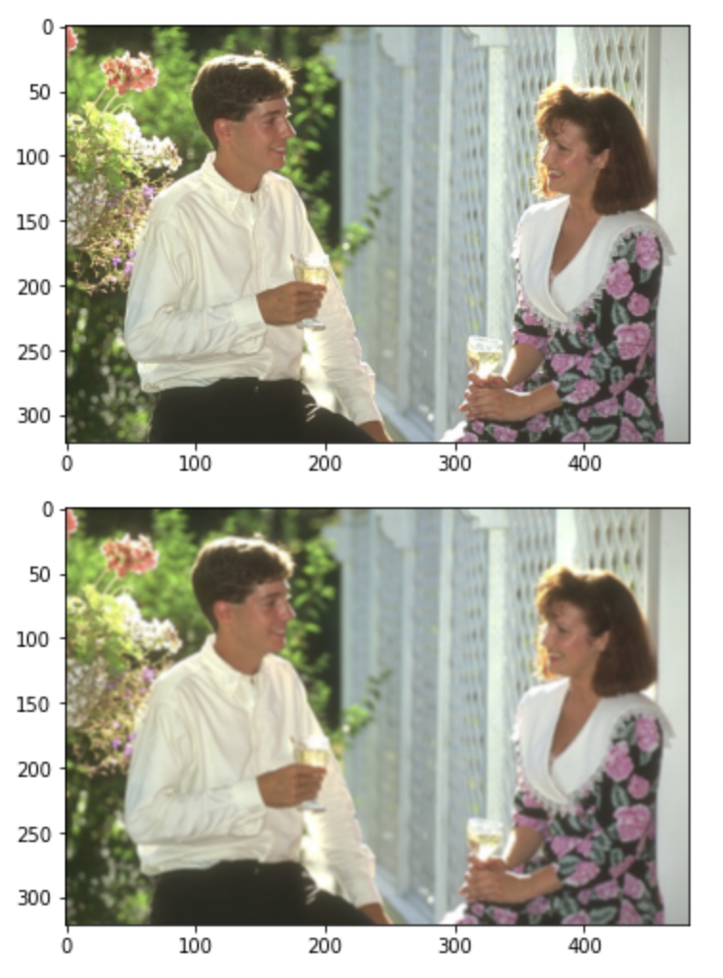
Applying model on actual images
Taking images from the original high resolution images dataset(top).
Adding some noise, or blurring them, or reducing their resolution to obtain a new image dataset(bottom).
We will now apply various machine learning techniques trying to get back the high resolution images from the blurred, or low resolution images.

Slide 16
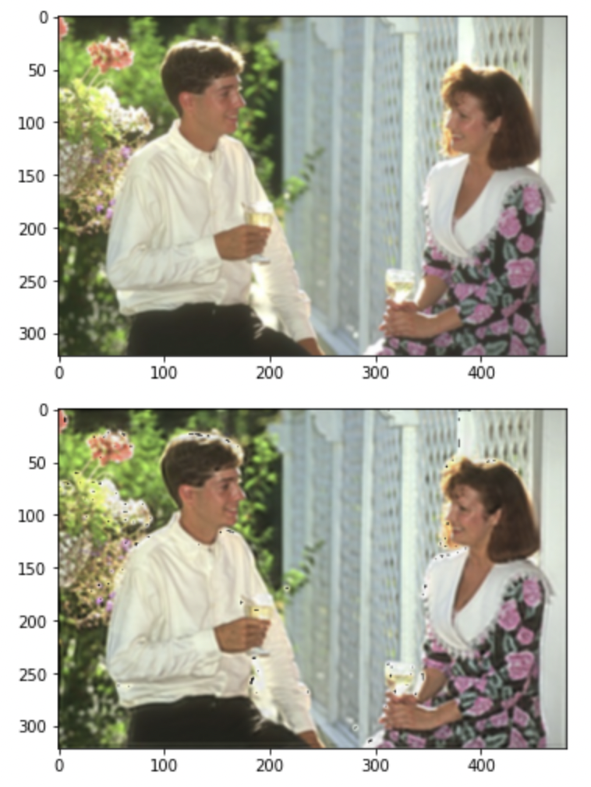
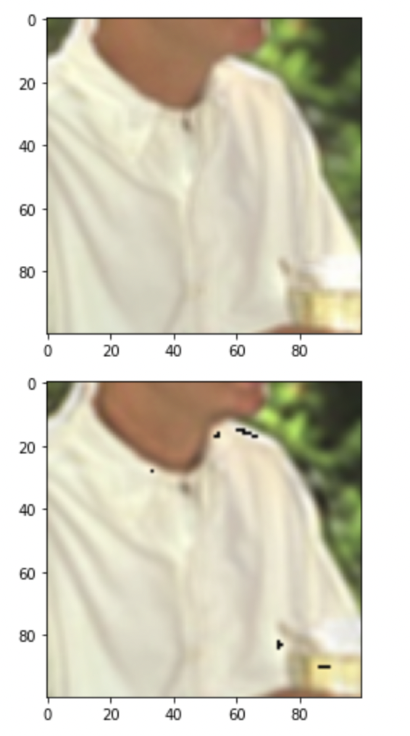
Applying Support Vector Regression
Left:The original blurred image(top) vs the transformed image(bottom).
Right: Zoomed in versions of the images on the left showing the difference.

Slide 17
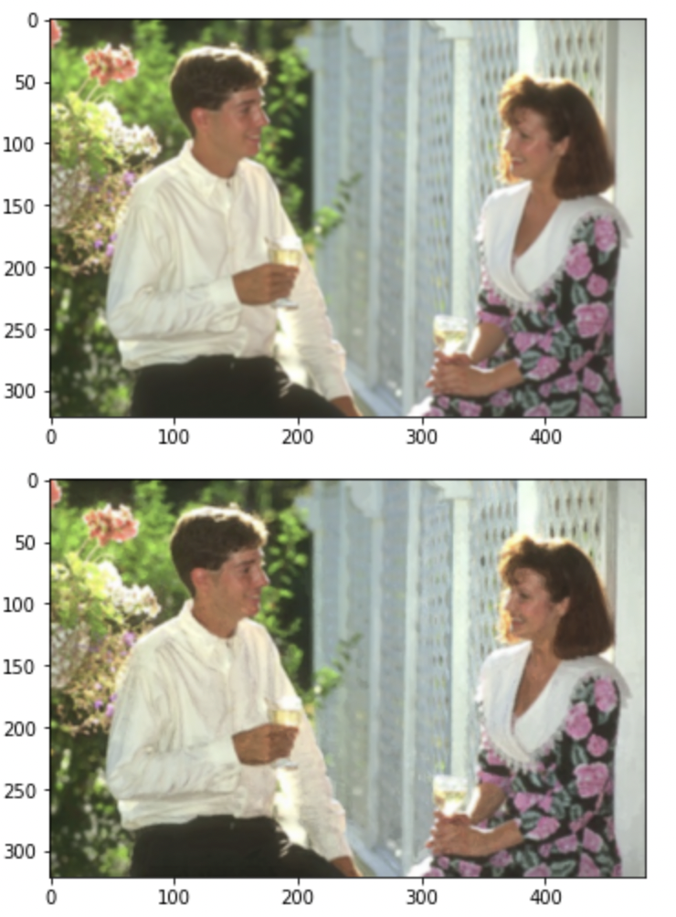
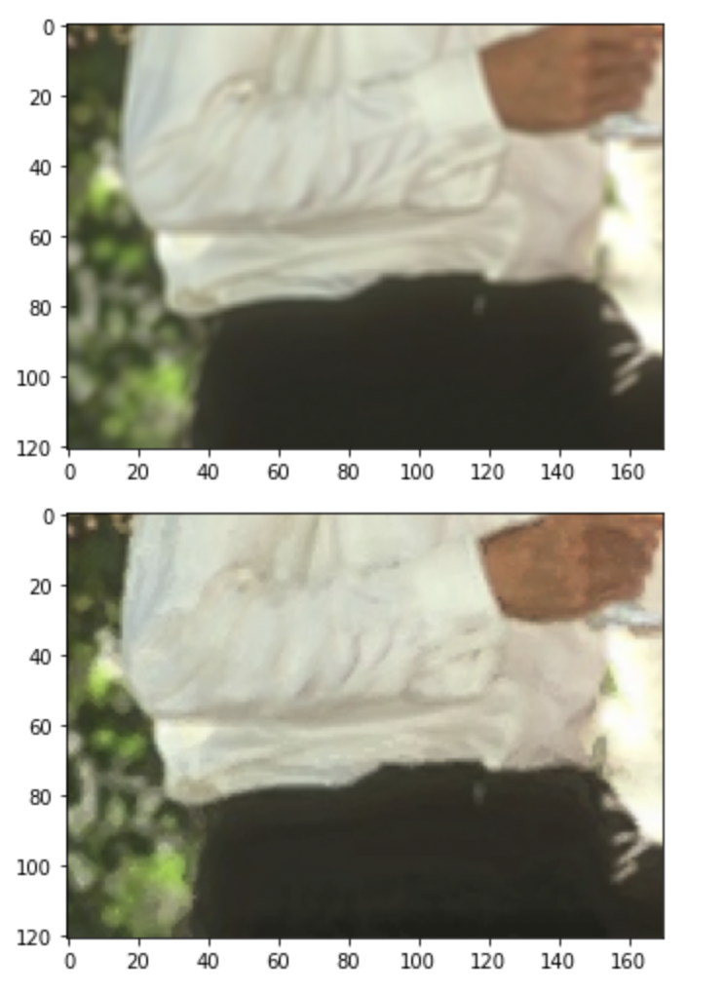
Applying Random Forest Regression
Left:The original blurred image(top) vs the transformed image(bottom).
Right: Zoomed in versions of the images on the left showing the difference.

Slide 18
Results
In case of Super Resolution and Denoising, evaluation is done using denoising approach on the standard dataset which consists of 9 colored images with noise strength of σ = 25.
A PSNR of 29.22 after 1800 optimization steps is achieved. The score is improved up to 30.43 if we additionally average the restored images obtained in the last iterations (using exponential sliding window).
The deep image prior is tested with different network architectures and a 35.05 PSNR is achieved for UNet and a 31.95 PSNR for ResNet.
Random Forest Regression performs better than the Support Vector Regression in deblurring the images.

Slide 19
References
05
Ulyanov, D., Vedaldi, A. & Lempitsky, V. Deep Image Prior. International Journal of Computer Vision, 2020.
https://doi.org/10.1007/s11263-020-01303-4
Albluvi, F.,Dahyot, R.,Image Deblurring and Super Resolution using Deep Convolution Neural Network,2018.
DOI: 10.1109/MLSP.2018.8516983

Slide 20
Thank You!!

